Slide 1


Critical mass for U-235 fission
Pratik T

Slide 2
Assumptions
Spherical mass of only U-235, no U-238
k_{eff} >1 is supercritical
4 processes: Fission, Absorption, Elastic and Inelastic scattering
3 energy ranges: Thermal, Epithermal, Fast
Crude angular dependence for scattering
Crude reflector design

Slide 3
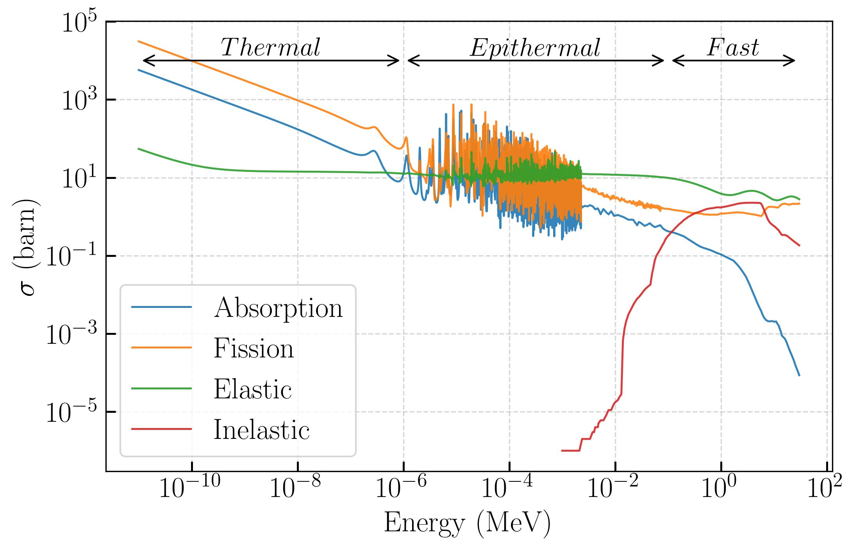
Cross Sections (ENDF)

Slide 4
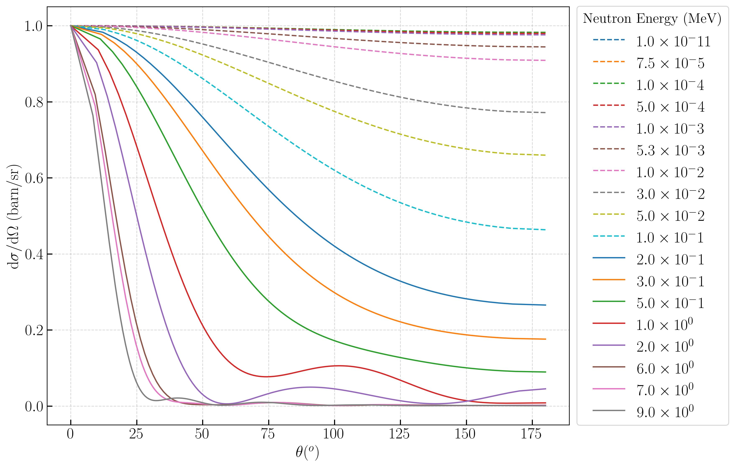
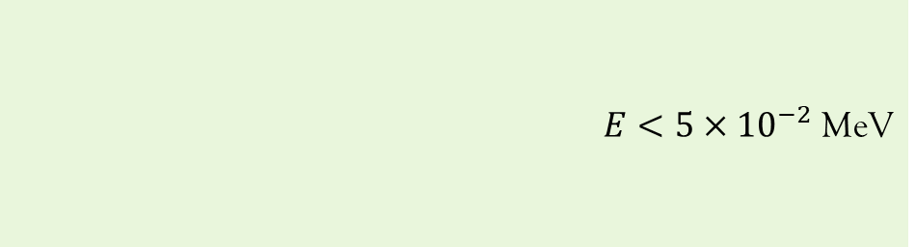
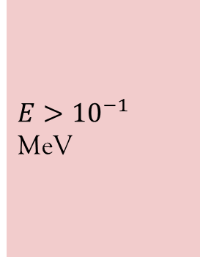
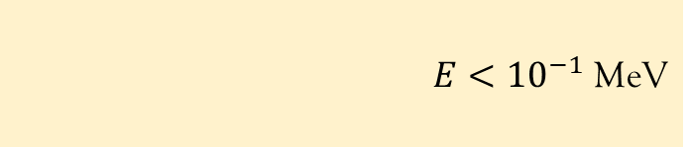
Angular dependence of elastic scattering (normalized)
$E<5×{10}^{−2}$ MeV
$E<{10}^{−1}$ MeV
$E>{10}^{−1}$ MeV

Slide 5
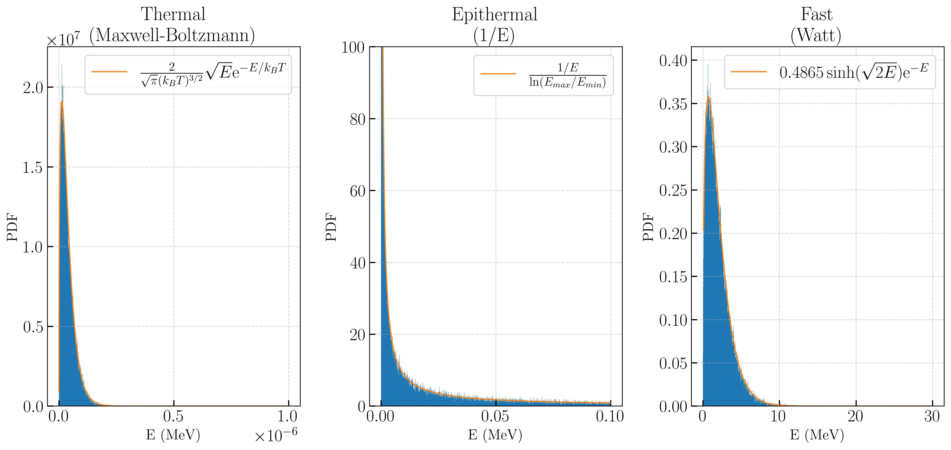
Energy distributions

Slide 6
Single neutron
Compute
$x_{f, p}=−\frac{ln\left(RND\right)}{nσ_{p}}$
and choose smallest
Choose random $φ, θ$ based on energy (isotropic for inelastic/fission, crude angular dependence for elastic)
Move to new position
Single neutron
Compute
𝑥_(𝑓, 𝑝)=−ln(𝑅𝑁𝐷)/(𝑛𝜎_𝑝 )
and choose smallest
Choose random 𝜙, 𝜃 based on energy (isotropic for inelastic/fission, crude angular dependence for elastic)
Move to new position
Elastic
Inelastic
Change energy to thermal/ epithermal
Add each to new gen
Fission
Create 2 or 3 neutrons with Watt energies
Continue tracking
Continue tracking
Stop tracking
Absorption
Stop tracking
Escape
Else stop tracking
If reflect, do nothing

Slide 7
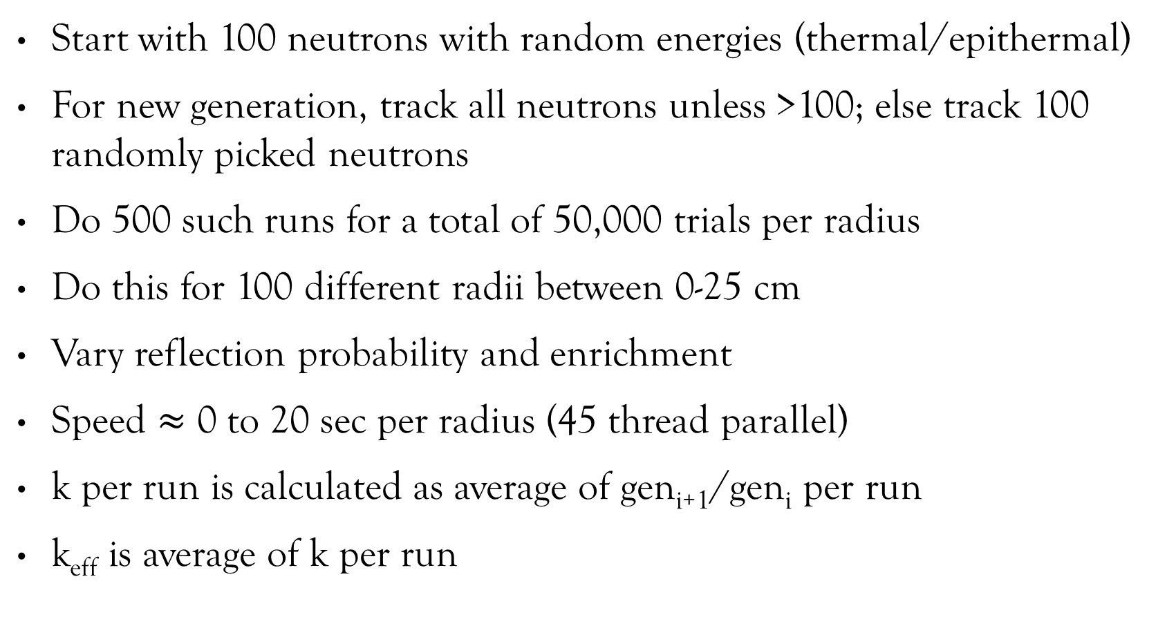
Logistics
Start with 100 neutrons with random energies (thermal/epithermal)
For new generation, track all neutrons unless >100; else track 100 randomly picked neutrons
Do 500 such runs for a total of 50,000 trials per radius
Do this for 100 different radii between 0-25 cm
Vary reflection probability and enrichment
Speed $≈$ 0 to 20 sec per radius (45 thread parallel)
k per run is calculated as average of gen_{i+1}/gen_{i} per run
k_{eff} is average of k per run

Slide 8
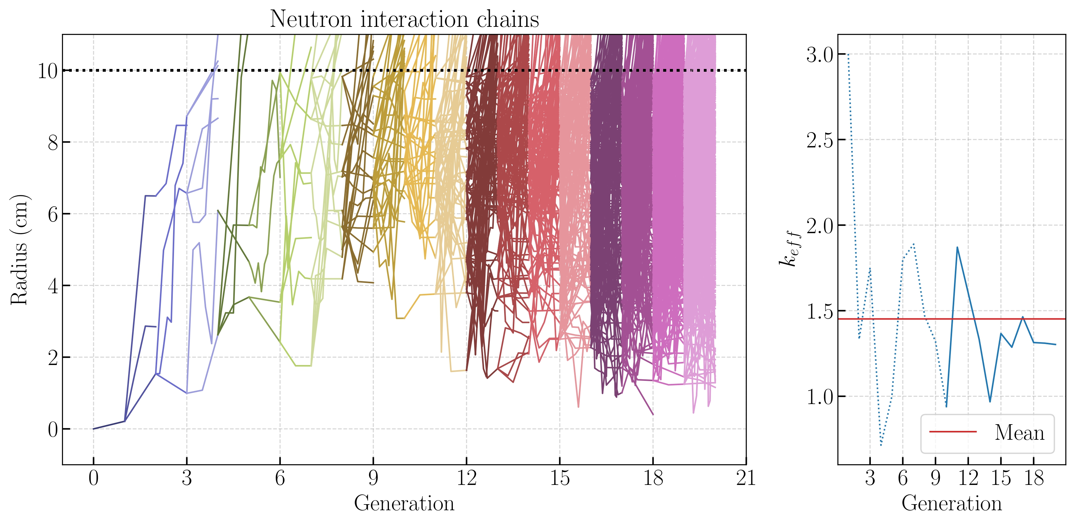


Slide 9
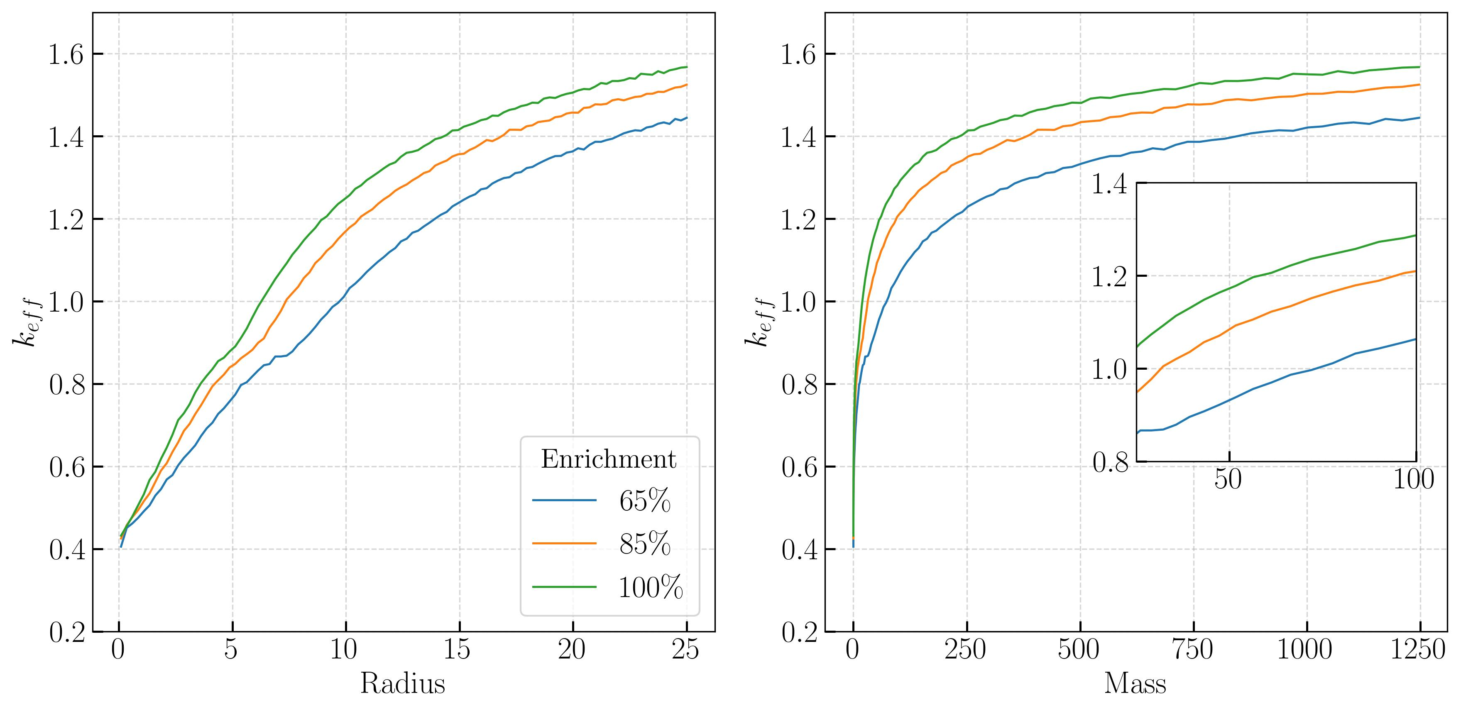
Results: no reflection

Slide 10
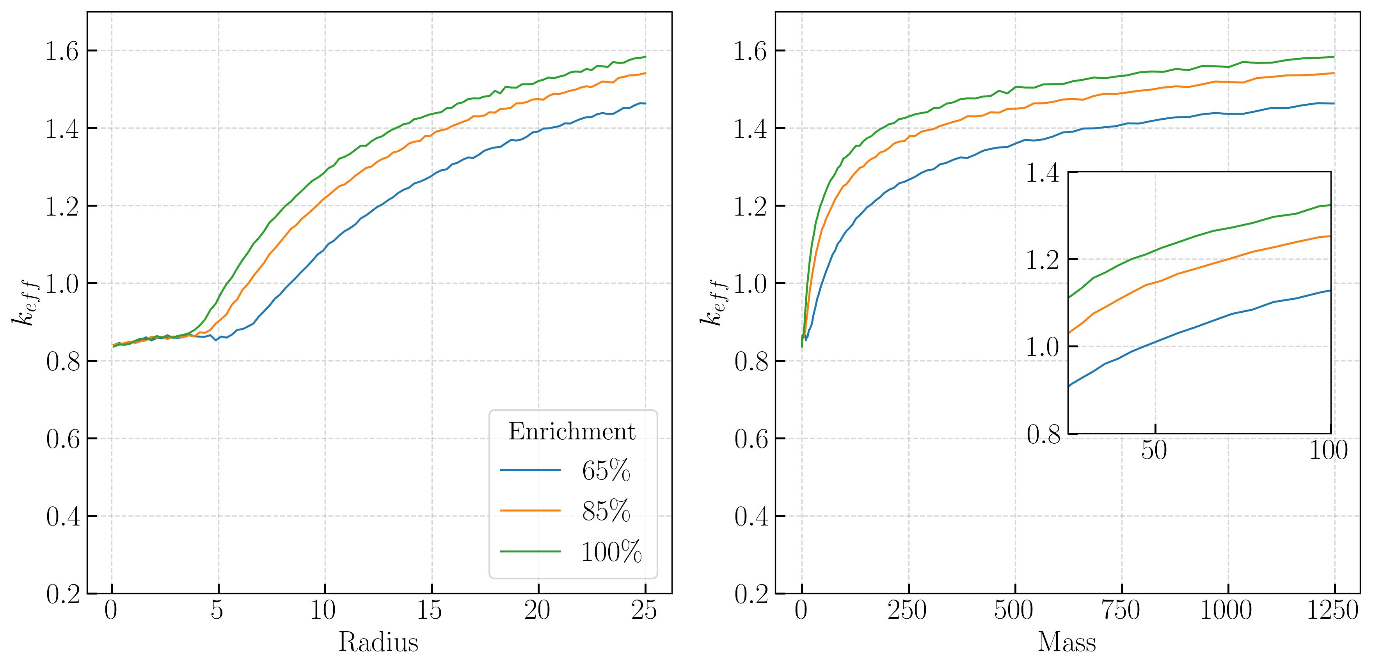
Results: 70% reflection

Slide 11
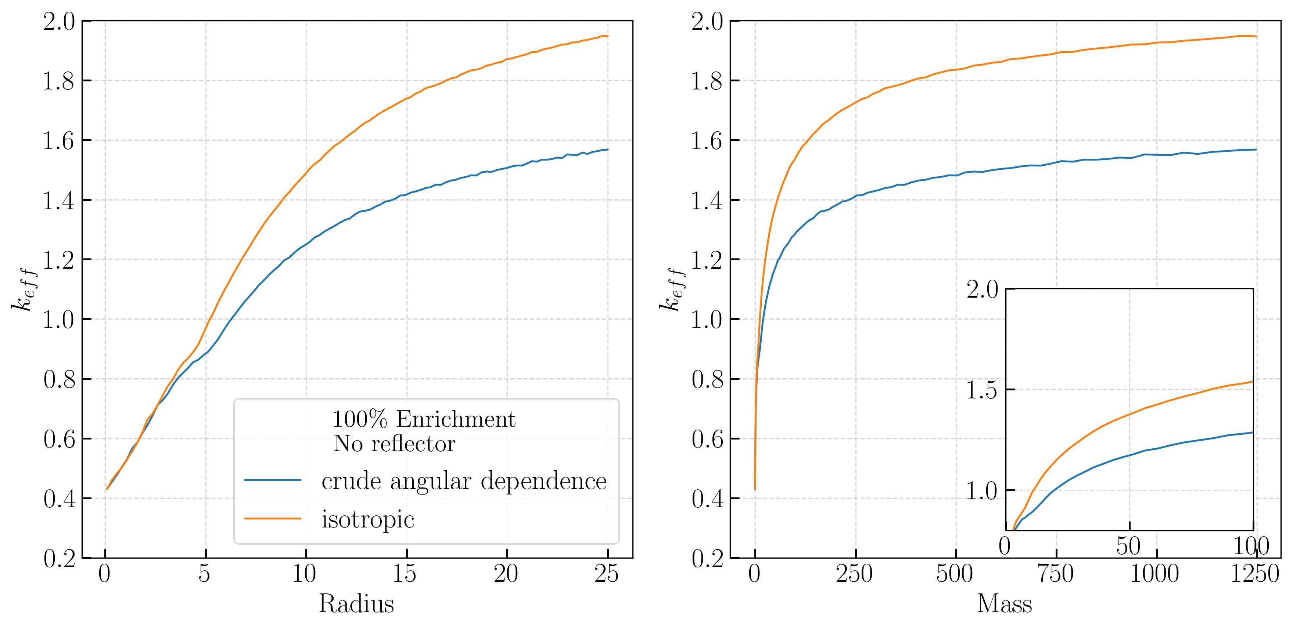
Results: Angular dependence of elastic scattering

Slide 12
